Slide 1

“ShelfWave” Transforming Inventory Gaps into Opportunity Waves
BY ALPHAWAVE SOLUTIONS
INTERNSHIP PROJECT I - COMP8967
Group - 4

Slide 2
Table of contents
01
02
03
05
INTRODUCTION
OVERVIEW
ASSESSMENT

Slide 3
01
INTRODUCTION

Slide 4

Inventory management is a critical aspect of any business that handles physical goods. Vendors need a reliable system to keep track of their inventory, update stock levels, and retrieve current inventory data to make informed decisions.
Combining machine learning for predictive inventory management with an interactive dashboard interface. It predicts inventory needs, prevents stockouts, and empowers users with real-time insights for enhanced operational efficiency and customer satisfaction.
Objectives: enhancing inventory accuracy, reducing instances of empty shelves, and optimizing stock control.
Goal: Aim to help retail stores manage empty shelves efficiently

Slide 5
02
Overview

Slide 6
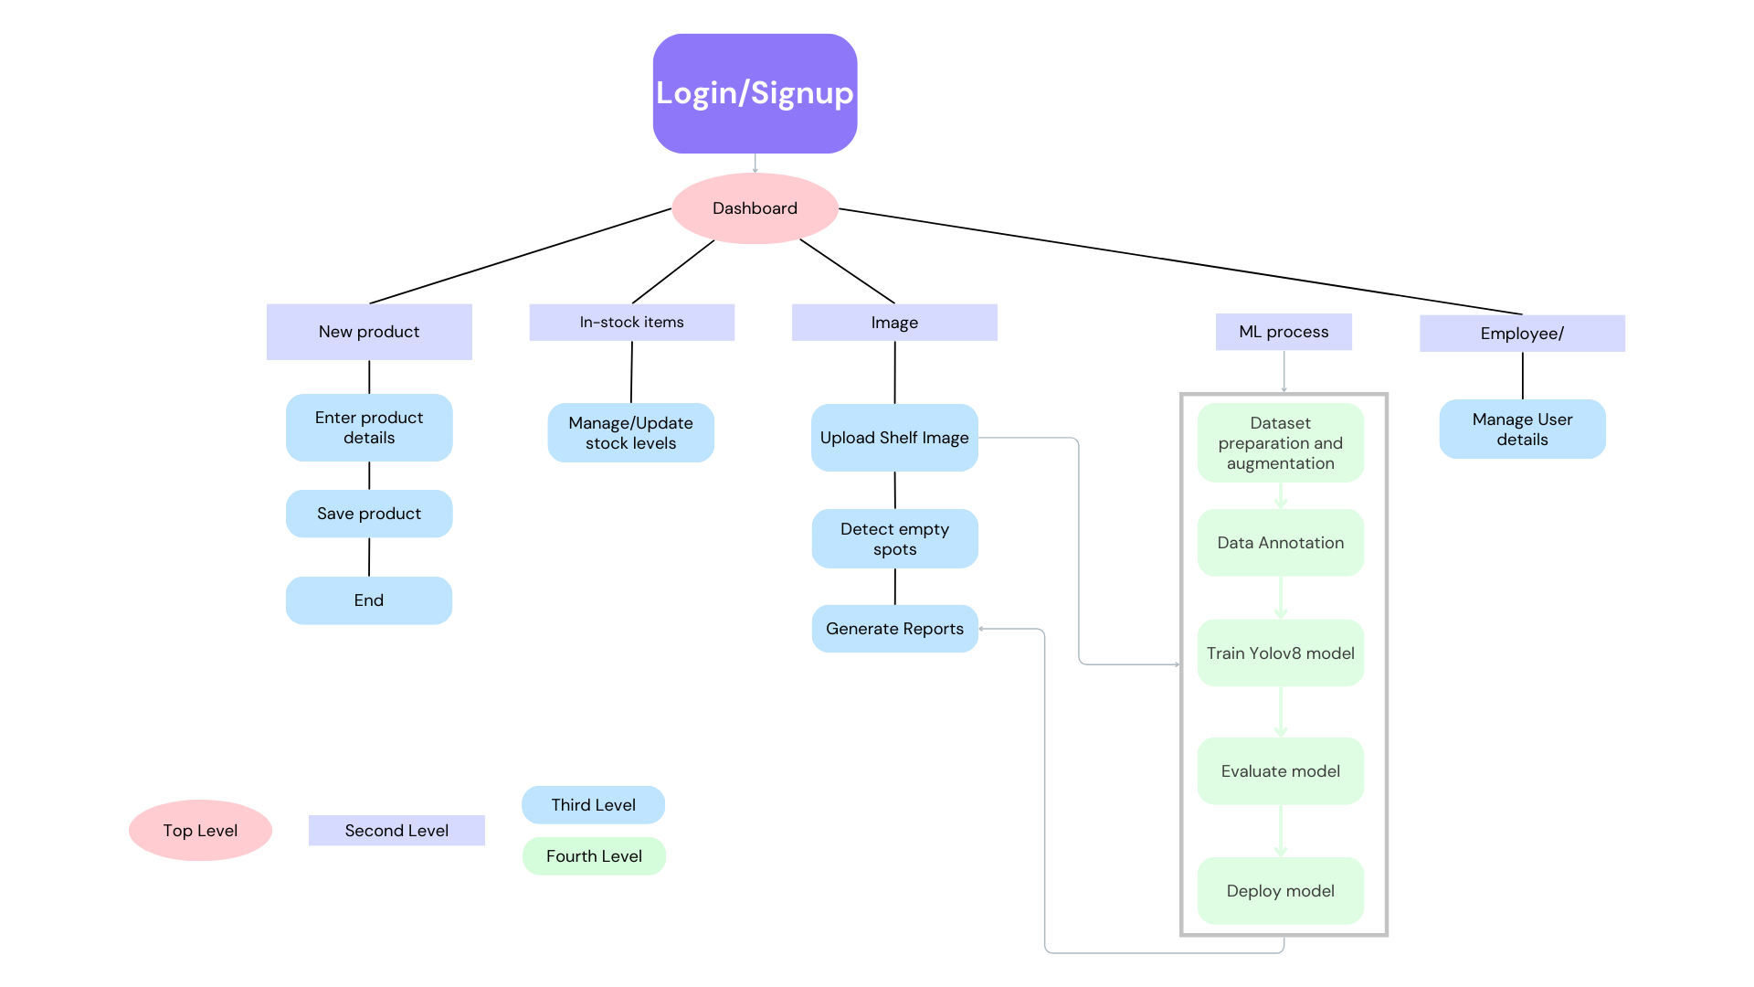

methodology

Slide 7

SHELFWAVES:
FRONT-END DEVELOPMENT: SMITA AND ARJUN
Designed and implemented the user interface
Created a clean and dynamic UI using Figma
Back-End Development: HARSH
Developed server-side logic and APIs
Testing and Reporting: BAUSHIL
Testing of the APIs
report preparation
MACHINE LEARNING MODEL: VATSAL AND RAHUL
Data collection: Vatsal and Rahul
Data Augmentation: Vatsal
Data Annotation: Vatsal and Rahul
Tasks

Slide 8
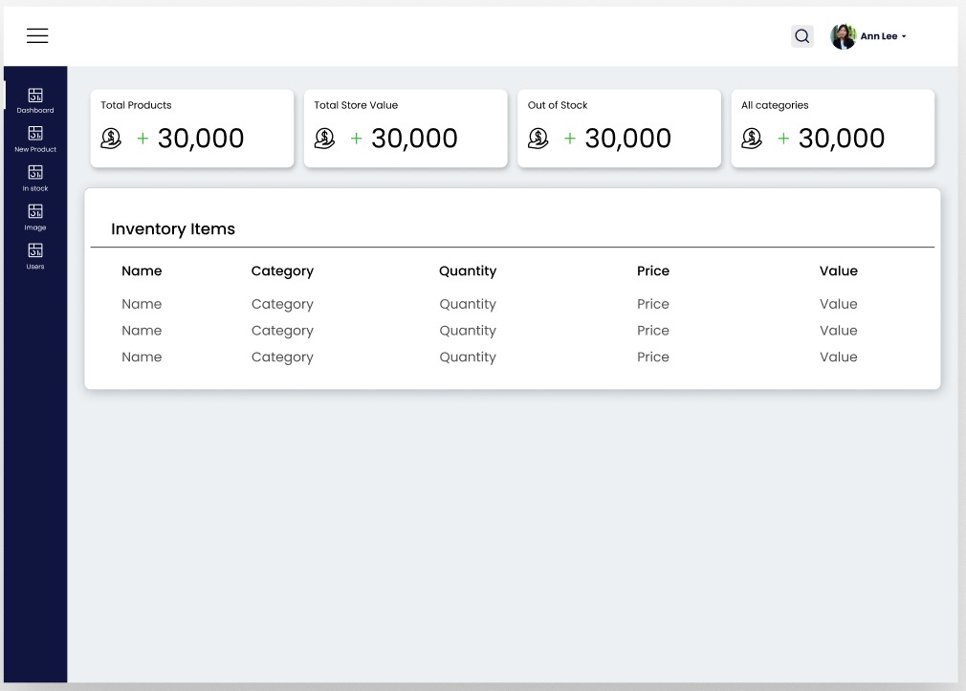
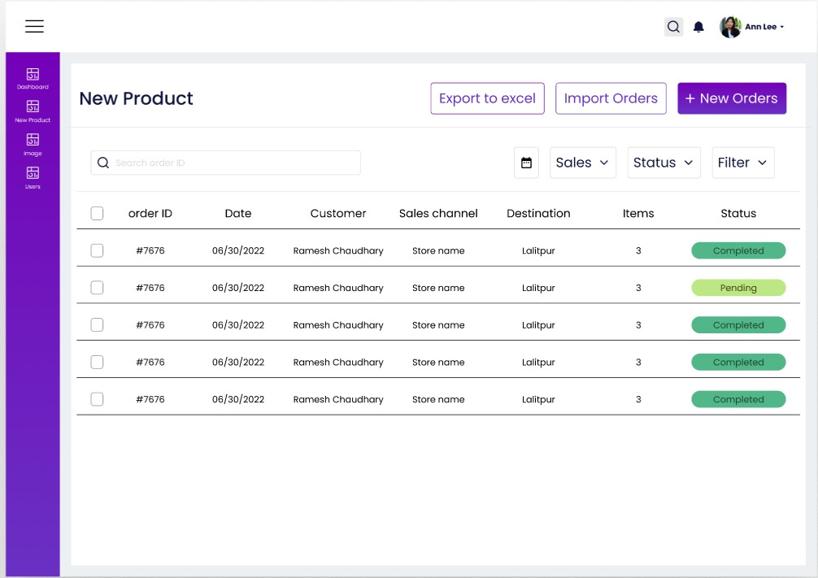
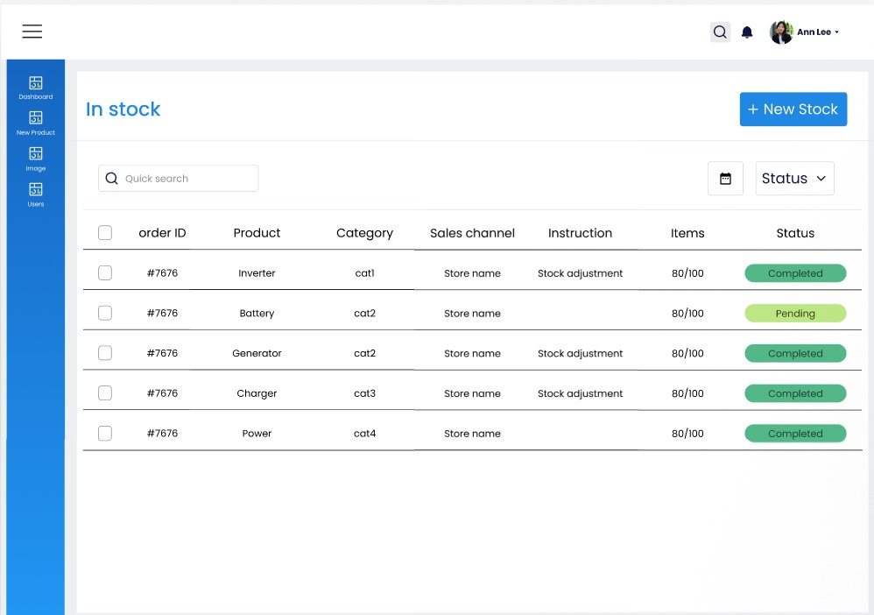

PROJECT TILL NOW
Sprint 1 Achievements:
Set up project repository
Data Collection for ML model
Created initial backend APIs
Designed initial UI mockups and documented application features
Designed initial UI mockups using Figma : Arjun and Smita

Slide 9
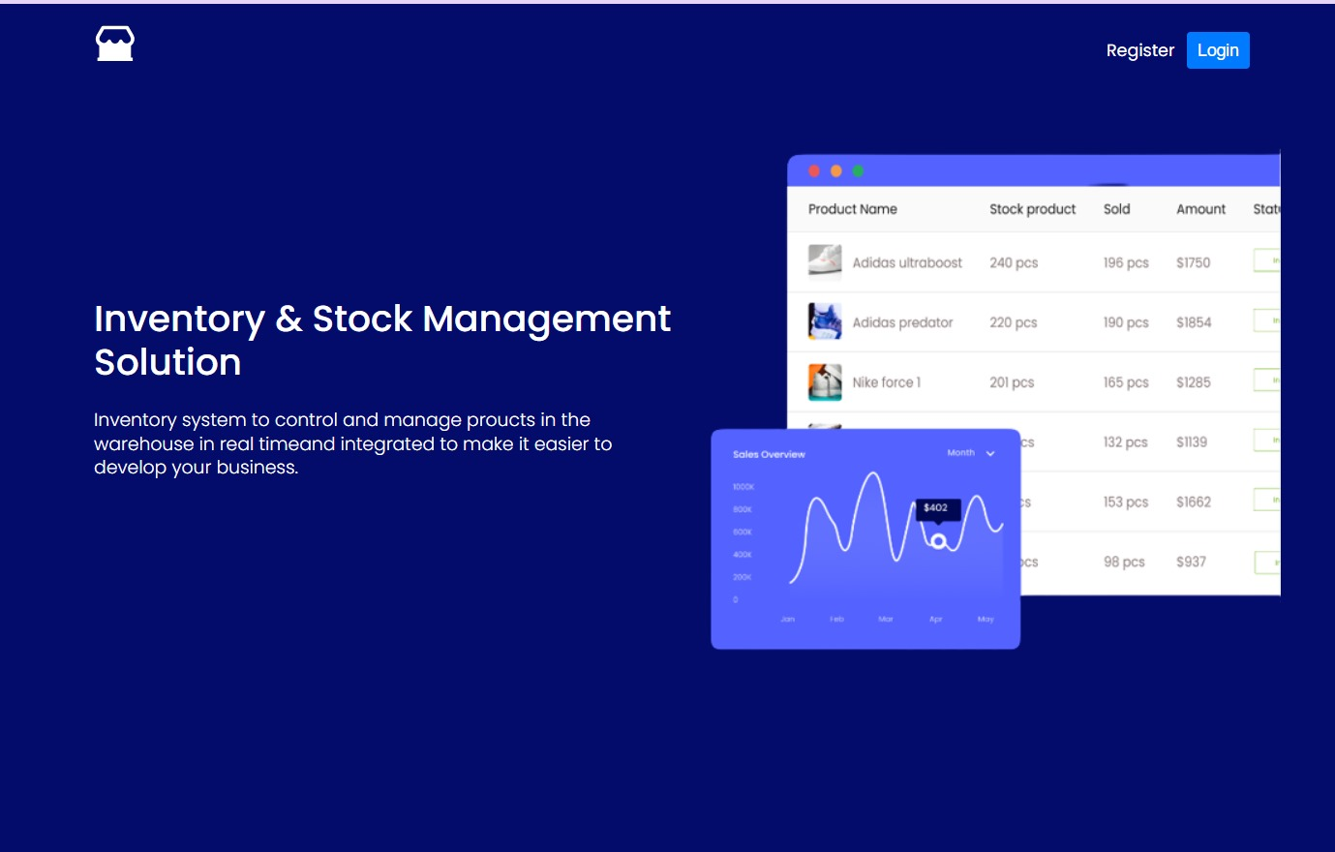
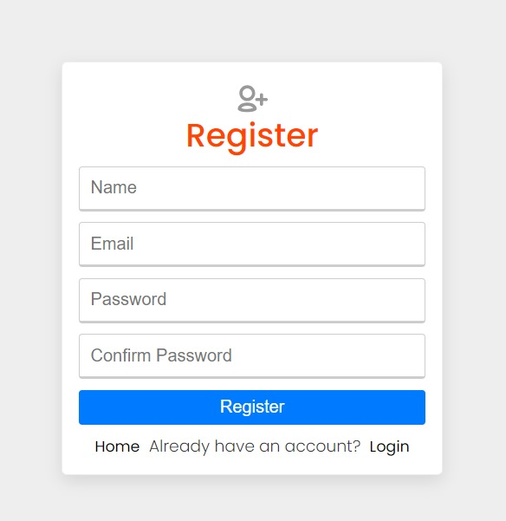
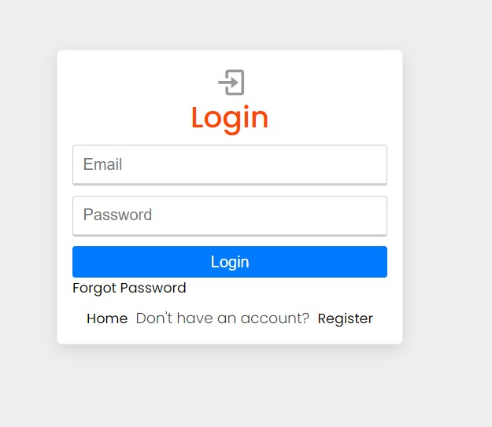
PROJECT TILL NOW
Sprint 2 Achievements:
Data Augmentation and Data annotation for ML model
Developed and tested user and authentication routes
Developed the frontend for user login and registration

Slide 10
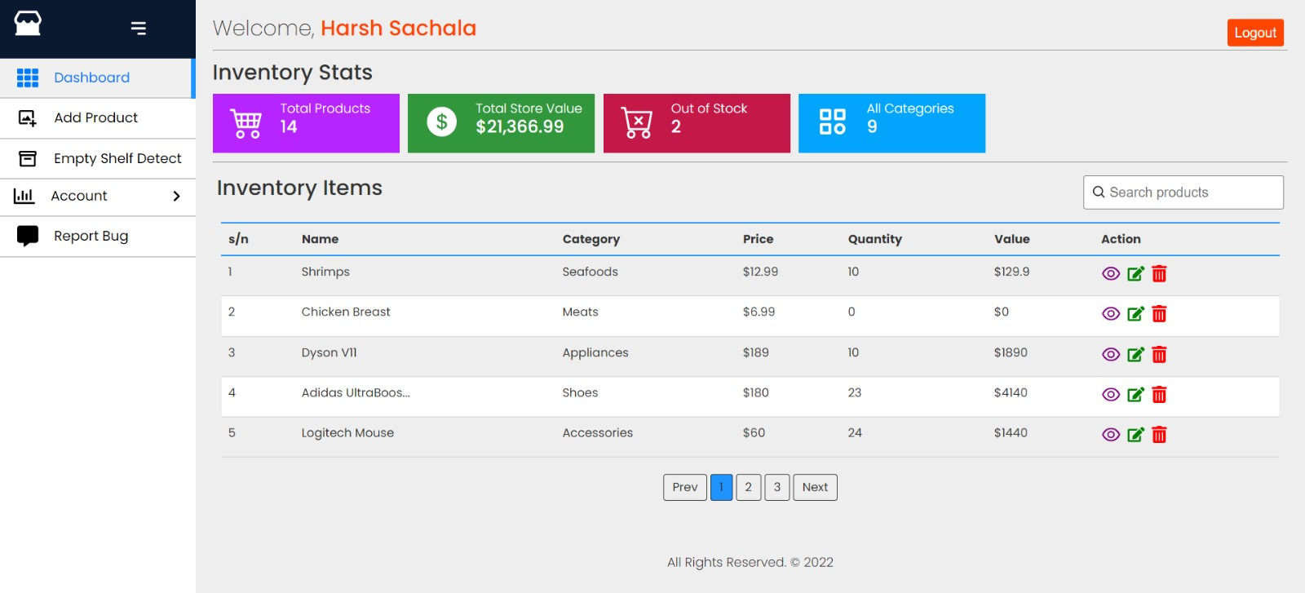
PROJECT TILL NOW
Sprint 3 Achievements:
Developed the product route.
Worked on login and forgot password functionality.
Initial model training.

Slide 11
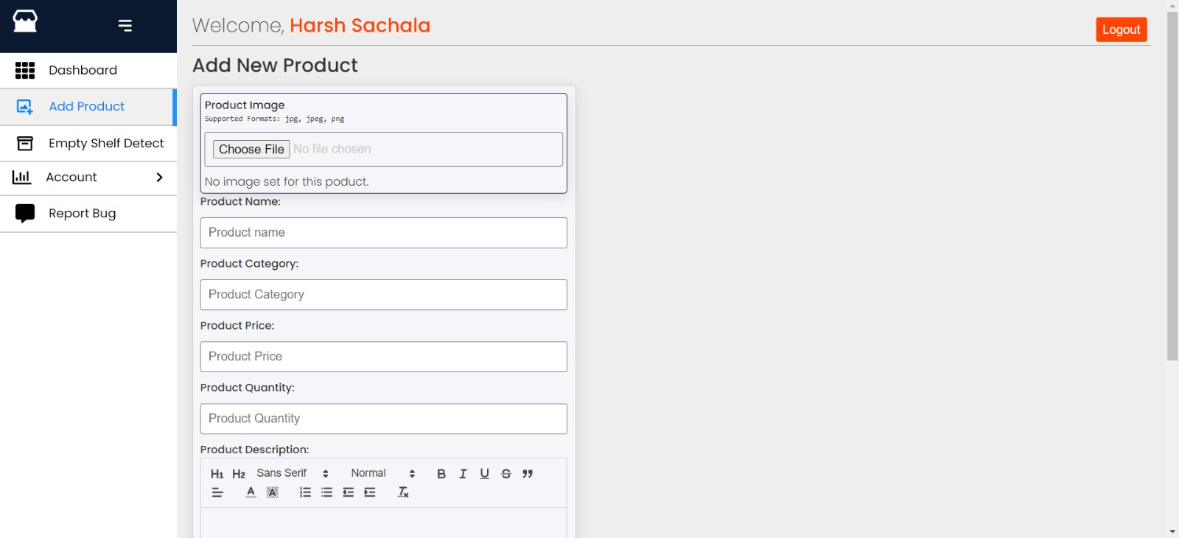
PROJECT TILL NOW
Sprint 4 Achievements:
Created homepage and dashboard
Bug fixes for the development till now.
Created and tested product route and user profile route.
API testing.

Slide 12
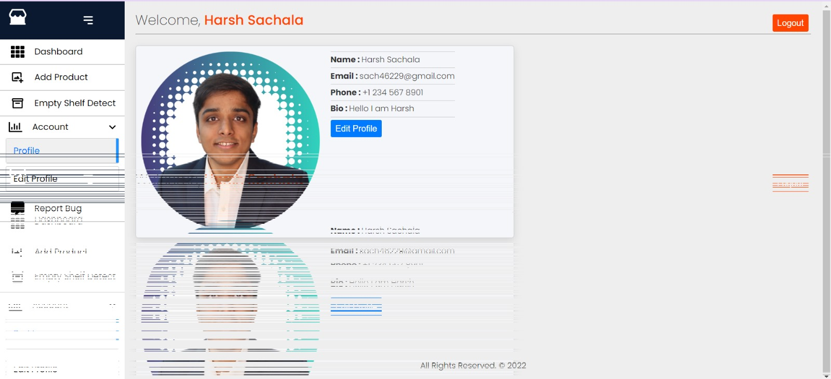
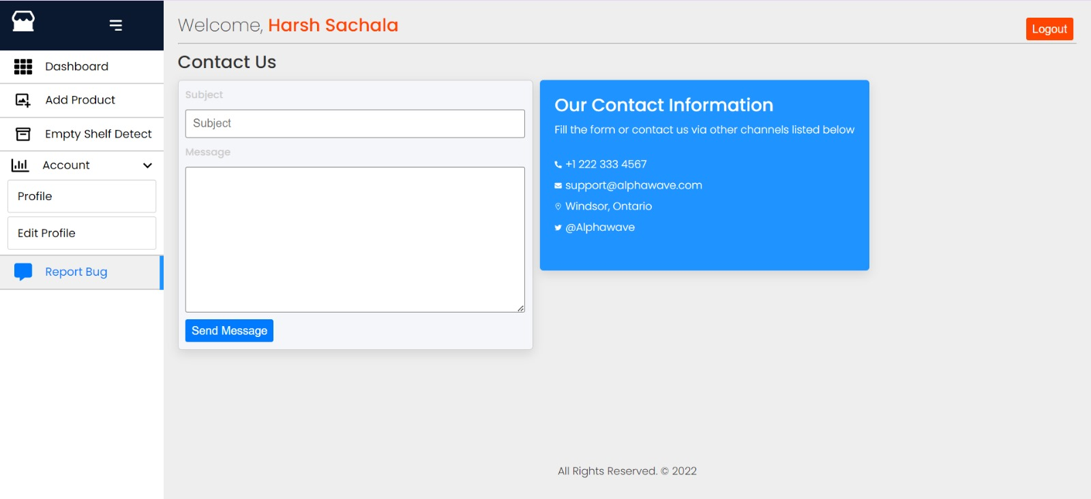
PROJECT TILL NOW
Sprint 5 Achievements:
Integration of frontend and backend.
Integration testing.

Slide 13
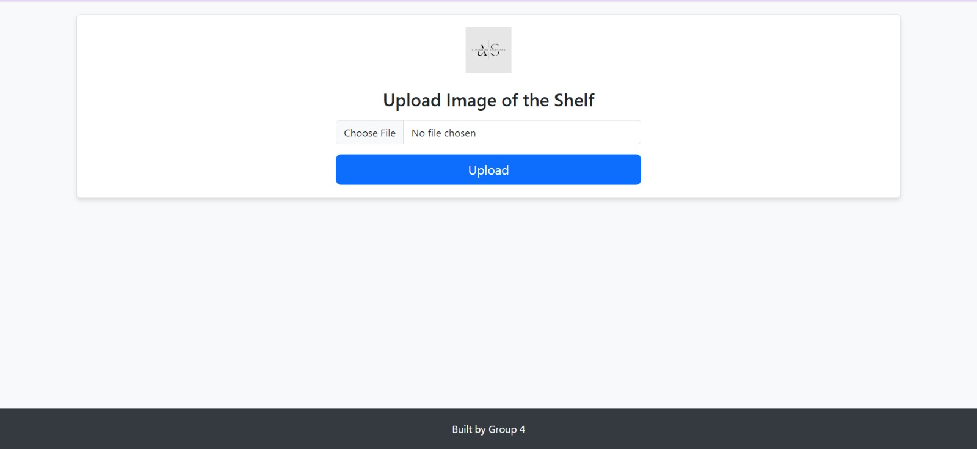
PROJECT TILL NOW
Sprint 5 Achievements:
Model Training and deployment.
Bug fixes for the model trained.

Slide 14
03
Assessment

Slide 15
What Went Well:
Successful development of the project with clear objectives and scope defined
Empty shelfs detected successful.
Team alignment and communication established for project implementation.
Challenges Faced:
The team faces challenges in creating a secure and user-friendly interface, including robust user authentication and real-time inventory updates.
developing an accurate ML model for detecting empty shelf spots and managing user roles and data privacy are significant hurdles.

Slide 16
Thank YOU
We are open to your questions.

